Slide 1

VNR VIGNAN JYOTHI INSTIIUTE OF ENGINEERING AND TECHNOLOGY Bachupally (via), Kukatpally, Hyderabad-72
EARLY PREDICTION OF DIABETES
BY
B.SNIGDHA SEKHAR(17071A05C8)
J.CHANDANA(17071A05E3)
A.BHARATH KUMAR(17071A05C4)
A.VENKATA RAMANA(17071A05C2)
GUIDED BY
MRS.PRIYANKA SINGH

Slide 2
ABSTRACT
Nowadays, diabetes has become a common disease to the mankind from young to the old persons.
Various traditional methods, based on physical and chemical tests, are available for diagnosing diabetes.
However, early prediction of diabetes is quite challenging task for medical practitioners due to complex interdependence on various factors.
The aim of this project is to develop a system which can perform early prediction of diabetes for a patient with a higher accuracy by combining the results of different machine learning techniques.

Slide 3
EXISTING SYSTEM:
The previously designed existing systems for early prediction of diabetes used ANN and KNN Algorithms.
The drawbacks were-After ANN training, the data may produce output even with incomplete information.
The lack of performance here depends on the importance of the missing information.
At the same time, KNN was slow and can be used for only a small set of training sets.
So the KNN combinations did not yield a high accuracy which was 72%.

Slide 4
PROPOSED SYSTEM:
Proposed procedure includes applying supervised machine learning algorithms based on Logistic Regression.
LR Logistic Regression scales relatively well to high dimensional data .
Logistic Regression is incredibly easy to implement and very efficient to train.
As ANN can train incomplete data it is very important to train the system perfectly with Logistic Regression compared to ANN with can lead to 80-87% accuracy.
Finally based on the result, a diet is prescribed for an individual.

Slide 5
DATASET USED:
The proposed methodology is being evaluated on Pima Indians Diabetes Dataset(PIDD) which is taken from UCI Repository.
The datasets consist of several medical predictor (independent) variables and one target (dependent) variable, Outcome.
Independent variables include Skin thickness, their BMI, insulin level, age, and so on.

Slide 6
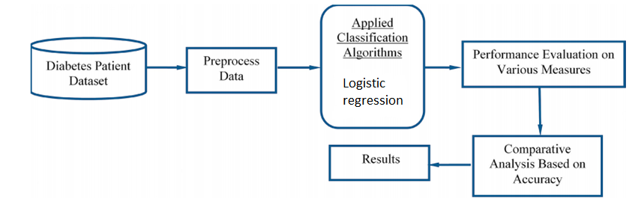
ARCHITECTURE OF SYSTEM
The architecture of Early diabetes Prediction System consists of:
Data Reader
EDP Software
Output Interface

Slide 7
MODULES AND THEIR FUNCTIONALITIES
The software system can be divided into four modules based on functionalities.
The modules are classified as:
Data Processing Module
System Training Module
Data Evaluation Module
Data Analysis Module

Slide 8
DATA PREPROCESSING MODULE:
When it comes to creating a Machine Learning model, data preprocessing is the first step marking the initiation of the process.
It is important to make the acquired data consistent so that it can be used to train the model without ambiguity.
It is pivotal to identify and correctly handle the missing values by deleting a particular row, by calculating the mean.
Failing to do this, you might draw inaccurate and faulty conclusions.
The user enters the data on the main screen and the data is then sent for data evaluation.

Slide 9
SYSTEM TRAINING MODULE
This module can be accessed by both admin and the end user.
Before predicting the presence of diabetes, the mandatory step is to provide the system with training.
This module supports:
Training the system with the pre-defined data.
Training the system with the new data that are not present in the system

Slide 10
DATA EVALUATION MODULE
Once the data enters the training set of the system, it is evaluated by using:
LOGISTIC REGRESSION ALGORITHM:
It is the appropriate regression analysis to conduct when the dependent variable is dichotomous (binary).
Like all regression analyses, the logistic regression is a predictive analysis.
Logistic regression is used to describe data and to explain the relationship between one dependent binary variable and one or more nominal, ordinal, interval or ratio-level independent variables.

Slide 11
DATA ANALYSIS MODULE
Once the data is evaluated and predicted into which class it belongs, it suggests the food habits, exercise habits which the person should follow it order to be healthy.

Slide 12
UML Diagrams:
Unified Modeling Language(UML) is a general purpose modeling language.
The main aim of UML is to define a standard way to visualize the way a system has been designed..
USE-CASE Diagrams:
Use Case Diagrams are widely used to illustrate the functional requirements of the system and its interaction with external agents (actors).

Slide 13
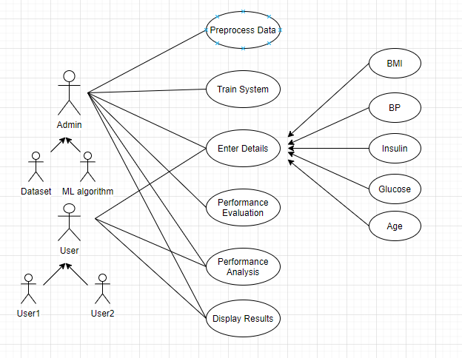
Over all Use-Case Diagram of EDP

Slide 14
CLASS DIAGRAMS
The class diagram is the main building block of object-oriented modelling.
The classes in a class diagram represent both the main elements, interactions in the application, and the classes to be programmed.

Slide 15
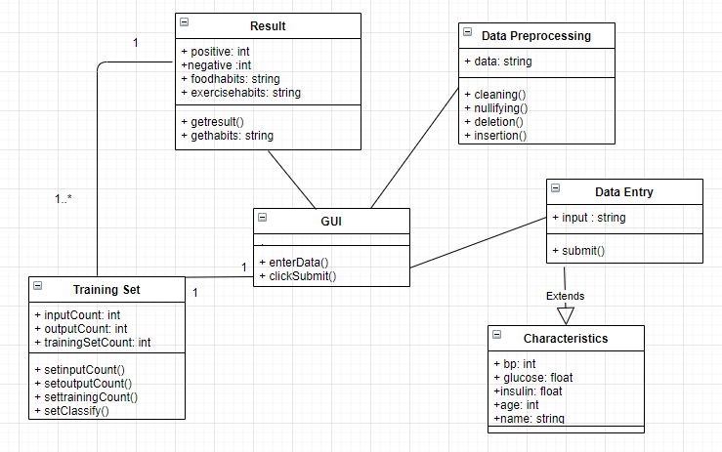
Class diagram for EPD

Slide 16
SEQUENCE DIAGRAM
A sequence diagram simply depicts interaction between objects in a sequential order i.e., the order in which these interactions take place.
Sequence diagrams describe how in what order the objects in a system function.

Slide 17
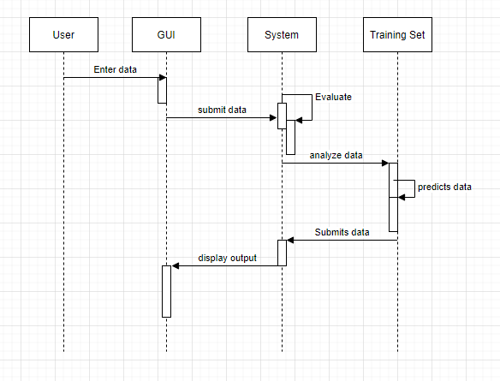
Sequence diagram for EDP

Slide 18
ACTIVITY DIAGRAM
Activity Diagrams are used to illustrate the flow of control in a system.
We can also use an activity diagram to refer to the steps involved in the execution of use case.

Slide 19
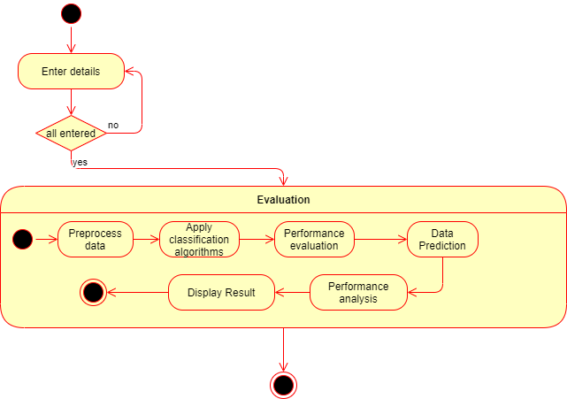
Activity diagram for EDP

Slide 20
COMPONENT DIAGRAM
Component diagram are used to represent the how the physical components in a system have been organized.
Component diagrams depict the structural relationship between software system elements.

Slide 21
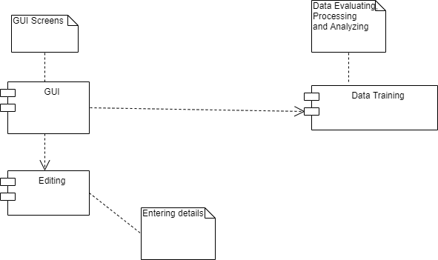
Component diagram for EDP

Slide 22
DEPLOYMENT DIAGRAM
Deployment Diagrams are used to represent system hardware and its software.
It tells us what hardware components exist and what software components run on them.

Slide 23
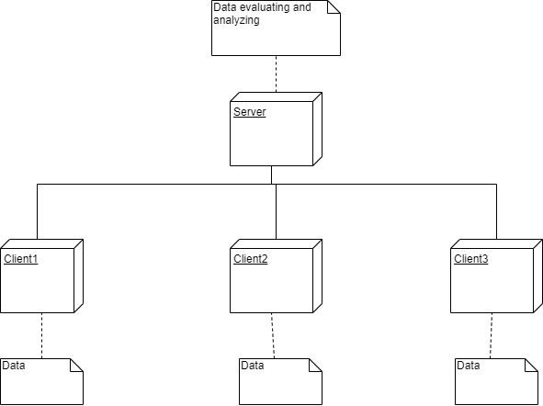
Deployment diagram for EDP

Slide 24
IMPLEMENTATION

Slide 25
TECHNOLOGIES USED
Basically to build our project we have used Python, HTML, CSS, JavaScript, Flask.
Tools used: We have used “JUPYTER lab and notebook” for executing machine learning programs in python.
JUPYTER NOTEBOOK:
The Jupyter Notebook is an open-source web application that allows you to create and share documents that contain live code, equations, visualizations and narrative text.

Slide 26
ALGORITHM USED:
The Algorithm used for training the system is Logistic Regression.
Logistic Regression Algorithm:
It is the appropriate regression analysis to conduct when the dependent variable is dichotomous (binary).
Like all regression analyses, the logistic regression is a predictive analysis.
Logistic regression is used to describe data and to explain the relationship between one dependent binary variable and one or more nominal, ordinal, interval or ratio-level independent variables.

Slide 27
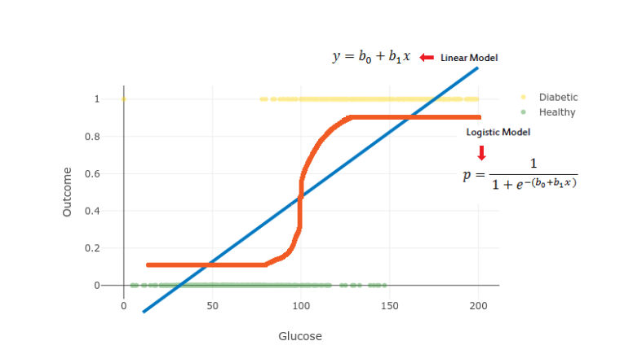
LOGISTIC REGRESSION:

Slide 28
LIBRARIES IMPORTED:
The libraries imported in our project are Seaborn, Matplotlib, Pandas, NumPy, Scikit-Learn, Pickle, OS.
Pandas:
It is built on the Numpy package and its key data structure is called the DataFrame.
DataFrames allow you to store and manipulate tabular data in rows of observations and columns of variables.

Slide 29
NumPy:
NumPy is a python library used for working with arrays.
It also has functions for working in domain of linear algebra, fourier transform, and matrices.
Matplotlib:
Matplotlib is a comprehensive library for creating static, animated, and interactive visualizations in Python.
Matplotlib makes easy things easy and hard things possible.

Slide 30
Seaborn:
Seaborn is a Python data visualization library based on matplotlib.
It provides a high-level interface for drawing attractive and informative statistical graphics.
Scikit-Learn:
Scikit-learn is a Python module integrating a wide range of state-of-the-art machine learning algorithms for medium-scale supervised and unsupervised problems.
This package focuses on bringing machine learning to non-specialists using a general-purpose high-level language.

Slide 31
Pickle:
Python pickle module is used for serializing and de-serializing python object structures.
The process to converts any kind of python objects (list, dict, etc.) into byte streams (0s and 1s) is called pickling.
OS:
The OS library in python is used for the purpose of Miscellaneous operating system Interfaces.

Slide 32
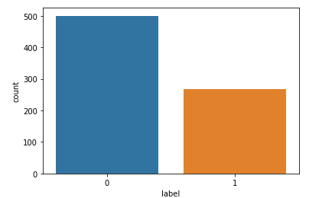
COUNT PLOT OF OUTCOME- LABEL DATASET USED: PIMA INDIA DIABETES

Slide 33
Step by step implementation:
Importing required modules or libraries like
Loading the dataset
Data Cleaning
Plotting Histograms
Splitting Dataset

Slide 34
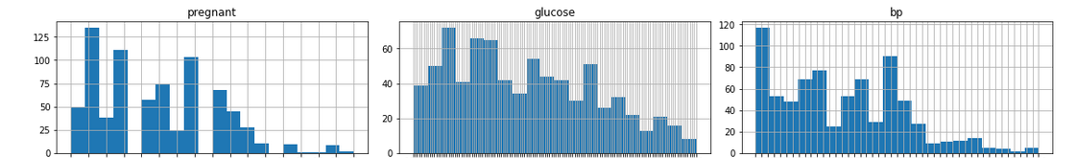
HISTOGRAMS FOR DATA VISUALIZATIONS:

Slide 35
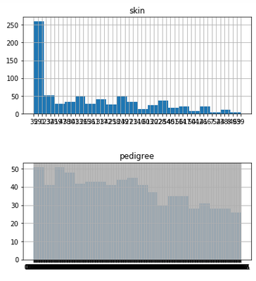
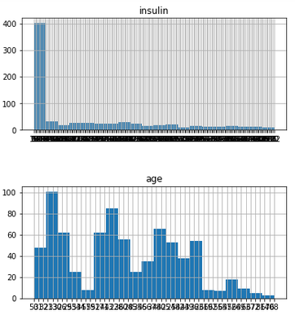
DATA VISUALIZATION TO BE CONTINUED…

Slide 36
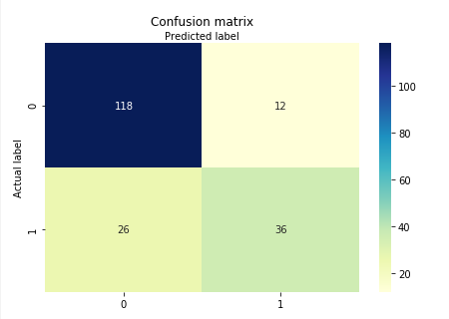
Applying Logistic Regression and fitting the model.
Predicting the output for our test set.
Creating a Confusion Matrix and Plotting it.

Slide 37
Determining accuracy
Taking the input values and predicting the output for given input.

Slide 38
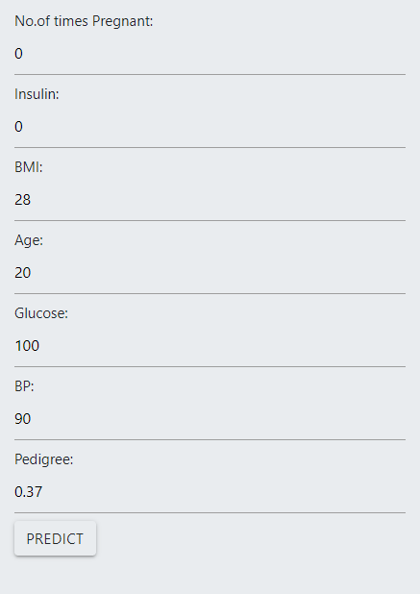
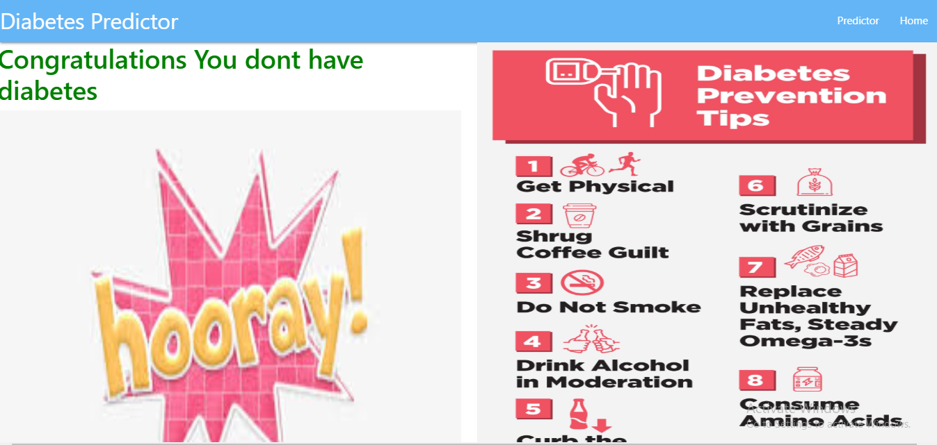
OUTPUT FOR NEGATIVE DIABETES

Slide 39
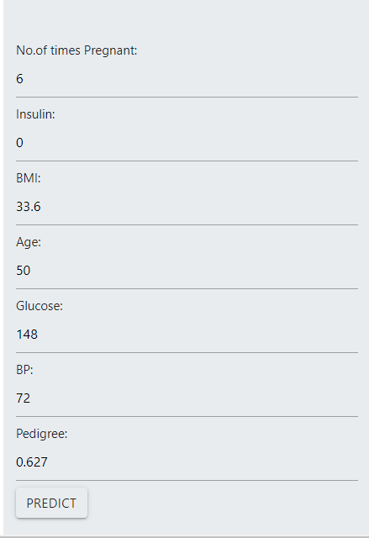
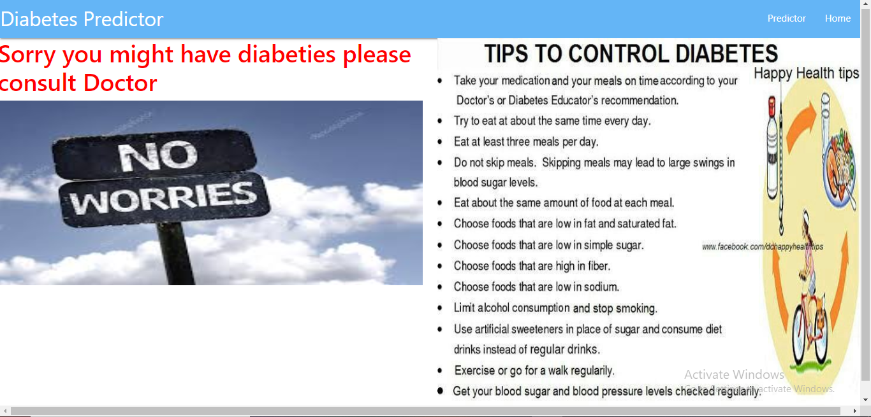
OUTPUT FOR POSITIVE DIABETES

Slide 40
ACCURACY:
Accuracy obtained from existing model using KNN algorithm is 76-78%.
Accuracy obtained from proposed model using Logistic Regression is 80-82%.

Slide 41
FUTURE SCOPE:
One of the important real-world medical problems is the detection of diabetes at its early stage.
In this study, systematic efforts are made in designing a system which results in the prediction of disease like diabetes.
In future, the designed system can be improved using PCA Principal Component Analysis and K-means Clustering .
The work can be extended and improved for the automation of diabetes analysis including some other machine learning algorithms.

Slide 42
CONCLUSION:
The existing model used KNN machine learning classification which obtained only 76-78% of accuracy.
Experiments are performed on Pima Indians Diabetes Database.
Experimental results determine the adequacy of the designed system with an achieved accuracy of 80-84% using the Logistic Regression algorithm hence proving to be the better model.

Slide 43
THANKYOU

